Slide 1
Embedded Systems Graduation Project
AUTONOMOUS CAR
By: Eng. Amr Hossam
Eng. Hussam Mostafa
Eng. Mohamed Badawy

Slide 2
INTRODUCTION What is an ‘Autonomous Car’?
An autonomous car is a vehicle capable of sensing its environment and operating without human involvement, but in order to do that, autonomous cars rely on sensors, that bounce pulses of light off the car’s surroundings to measure distances, detect edges.
The Autonomous Car project consists of:
Ultrasonic Sensor Module HC- SR04.
Servo motor.
L293D Motor Driver.
DC Motors.

Slide 3
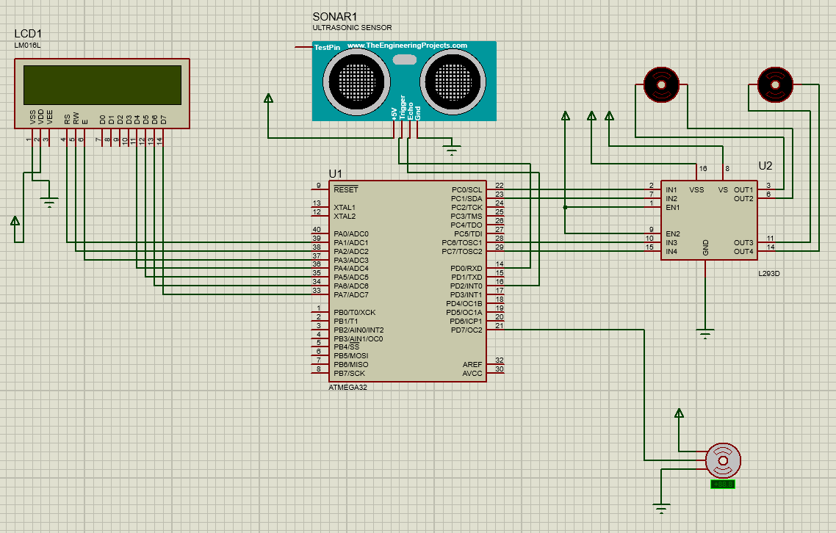
Project Circuit Diagram
https://github.com/amrhossam94/D25---Autonomous-Car

Slide 4
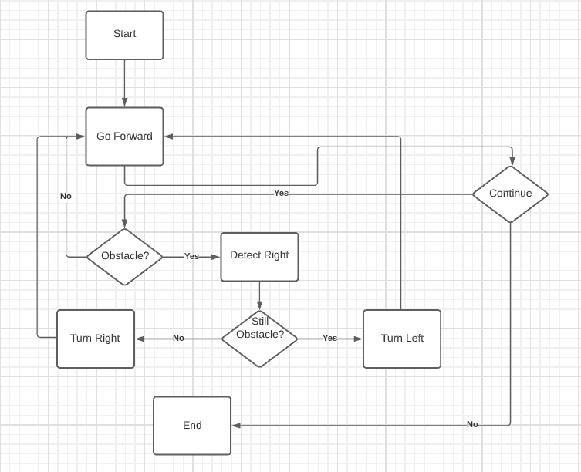
Project Flow Diagram

Slide 5
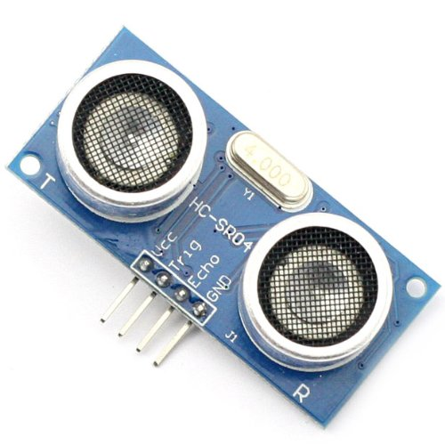
HC-SR04 - Ultrasonic Sensor
HC-SR-04 module has an ultrasonic transmitter, receiver, and control circuit on a single board.
The module has only 4 pins, Vcc, Gnd, Trig, and Echo.

Slide 6
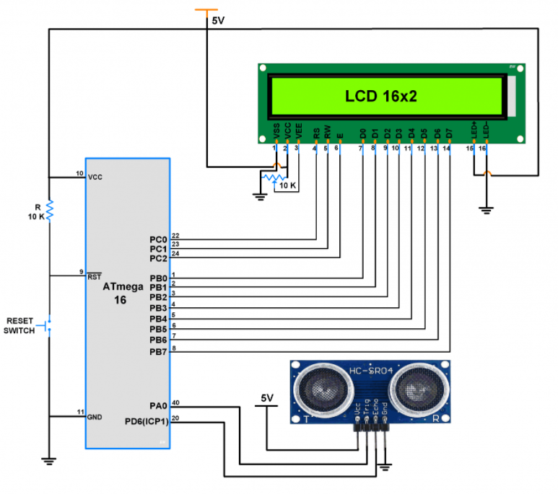
HC-SR04 - Ultrasonic Sensor
When a pulse of 10µsec or more is given to the Trig pin, 8 pulses of 40 kHz are generated. After this, the Echo pin is made high by the control circuit in the module.
The echo pin remains high till it gets an echo signal of the transmitted pulses back.

Slide 7
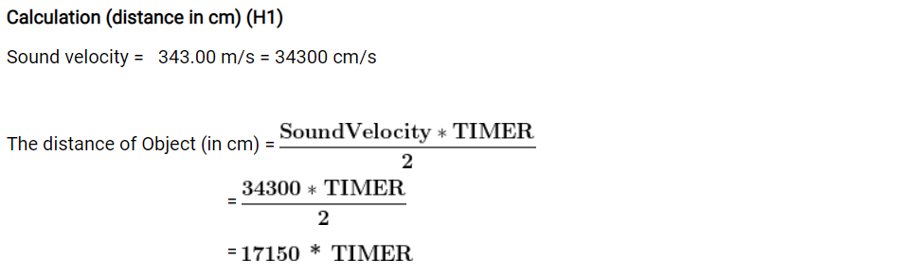
Now, here we have selected an internal 16MHz oscillator frequency for ATmega32, with No-presale for timer frequency. Then time to execute 1 instruction is 0.0625 us.
So, the timer gets incremented after 0.0625 us time elapse.
= 17150 x (TIMER value) x 0.0625 x 10^-6 cm
= 0.0625 x (TIMER value)/58.30 cm
= (TIMER value) / 932.8 cm

Slide 8
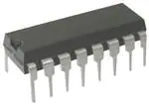
L293D – Motor Driver
L293D is a most popular and less expensive built-in H-bridge in a small integrated circuit used for low current motors, such as DC motors.
H-bridge is a motor driving unit used to control the direction of two motors at a time either clockwise or anticlockwise direction.

Slide 9
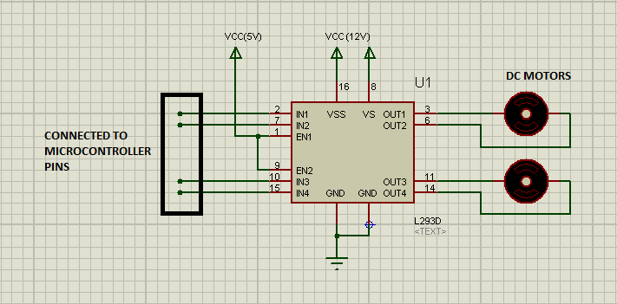
L293D Circuit Diagram
It is a16 pin IC in which pins OUT1, OUT2, OUT3 and OUT4 are connected to TWO motors.
Pin EN1 & EN2 are PWM pins while IN1, IN2, IN3 & IN4 are used to provide signals to the motors.

Slide 10
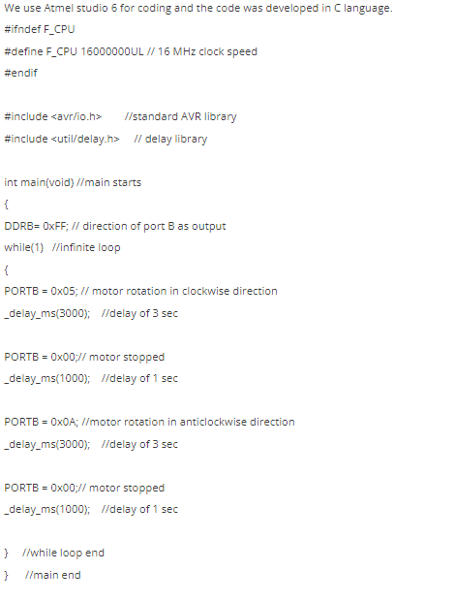
Code Example

Slide 11
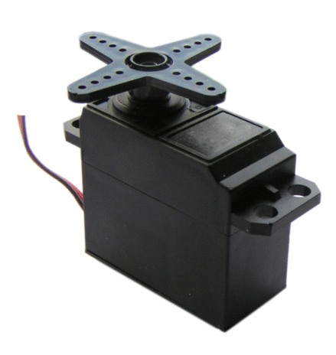
SG90 - Servo Motor
A servo motor is an electric device used for precise control of angular rotation. It is used where precise control is required.
The rotation angle of the servo motor is controlled by applying a PWM signal to it.

Slide 12
Duty Cycle Time
SG90 servo motor practical duty cycle time for -90° to +90 rotation.
At ~0.056ms duty cycle we get shaft position at -90° of its rotation.
At ~0.092ms duty cycle we get shaft position at 0° (neutral) of its rotation.
At ~0.124ms duty cycle we get shaft position at +90° of its rotation.

Slide 13

Generating PWM using AVR ATmega32
To control servo motor in between -90° to +90° rotation. We need to generate a PWM waveform of 50Hz with duty cycle variation from ~0.056ms to ~0.124ms. We can use a Fast PWM mode of ATmega32 using Timer1.
Where N is prescaler divider i.e. 1, 8, 64, 256, or 1024
50Hz = 16,000,000Hz/(64(1+TOP))
=> TOP = ICR1 = 4999

Slide 14
AVR ATmega32 Program to generate 50Hz PWM to control Servo Motor in an angle between -90° to +90° rotation.
For SG90 Micro servo motor, here we get practically -90° at 0.056ms duty cycle Period of 50Hz PWM, so we are going to load OCR1A = 14.
Note: 0.056ms * (1ms/4us) = 14, and it’s 4us because -----> (1/250KHz = 4us)
After 0° at 0.092ms duty cycle Period of 50Hz PWM, so we are going to load OCR1A = 23.
And +90° at 0.124ms duty cycle Period of 50Hz PWM, so we are going to load OCR1A = 31.

Slide 15
Summary
In conclusion, an autonomous car can go anywhere a traditional car goes and do everything that an experienced human driver does.
A human passenger is not required to take control of the vehicle at any time, nor is a human passenger required to be present in the vehicle at all.

